Slide 1
Representation learning
Date: 07.11.2022

Slide 2
Representation learning
Learning representations of the data that make it easier to extract useful information when building classifiers or other predictors.
A good representation is one that makes a subsequent learning task easier.

Slide 3
Representation learning in neural network
We can think of feedforward networks trained by supervised learning as performing a kind of representation learning.
Specifically, the last layer of the network is typically a linear classifier, such as a softmax regression classifier. The rest of the network learns to provide a representation to this classifier.
Training with a supervised criterion naturally leads to the representation at every hidden layer (but more so near the top hidden layer) taking on properties that make the classification task easier. For example, classes that were not linearly separable in the input features may become linearly separable in the last hidden layer.

Slide 4
Most representation learning problems face a tradeoff between preserving as much information about the input as possible and attaining nice and independent properties.
Training with supervised learning techniques on the labeled subset often results in severe overfitting. Semi-supervised learning offers the chance to resolve this overfitting problem by also learning from the unlabeled data.
Specifically, we can learn good representations for the unlabeled data, and then use these representations to solve the supervised learning task.There are many ways to leverage unlabeled data.
In this chapter, we focus on the hypothesis that the unlabeled data can be used to learn a good representation

Slide 5
Greedy Layer Wise Unsupervised Pretraining
Greedy layer wise unsupervised pre-training relies on a single-layer representation learning algorithm such as an RBM, a single-layer autoencoder, a sparse coding model,or another model that learns latent representations.
Greedy: because it is uses greedy algorithm, which optimizes each piece of the solution independently, one piece at a time, rather than jointly optimizing all pieces.
Layer-wise: because these independent pieces are the layers of the network
(Idea is: Specifically, greedy layer-wise pretraining proceeds one layer at a time, training the k-th layer while keeping the previous ones fixed)
Unsupervised because each layer is trained with an unsupervised representation learning algorithm.
Pretraining: because it is supposed to be only a first step before a joint training algorithm is applied to fine-tune all the layers together.

Slide 6
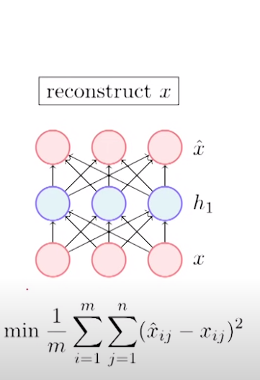
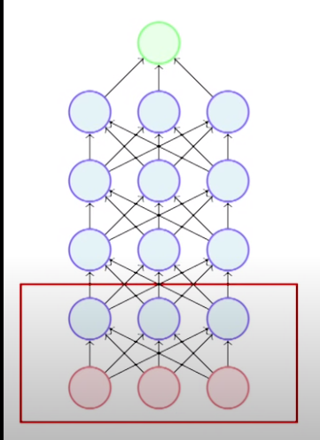
Consider this deep neural network model.
1st step: focus on 1st two layers (x,h1).
We will first train the weights between two layers using an unsupervised objective.
Note that we are trying to reconstruct the input x from hidden representation h1

Slide 7
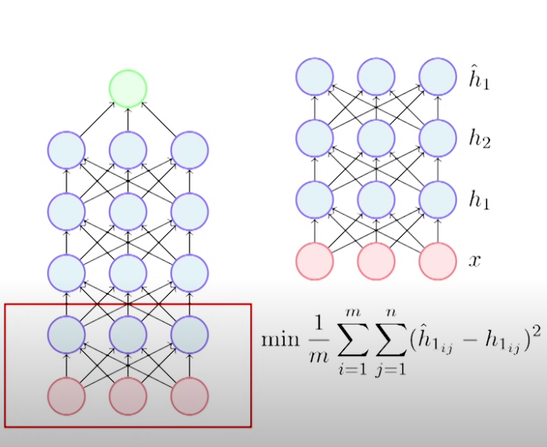
After step 1 , the weights in layer 1 is trained such a way that h1 captures abstract representation of input x.
Now we fix the weights in layer 1 and repeat the same process with layer 2

Slide 8
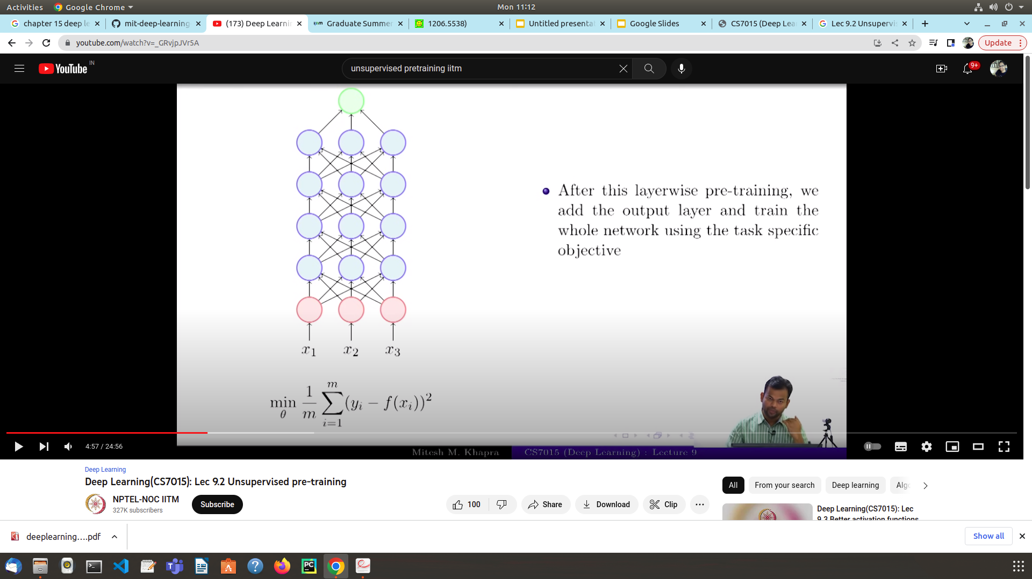
After this layer-wise pre-training,we add the output layer and train the whole network for its corresponding classification or prediction task.

Slide 9
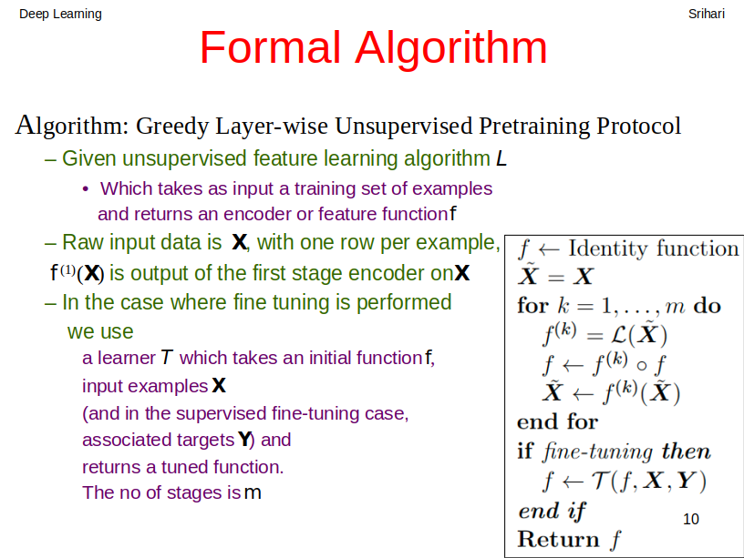

Slide 10
Better optimization:
Unsupervised pre-training puts the network in a region of parameter space where basins of attraction run deeper than when starting with random parameters. In simple words, the network starts near a global minimum. In contrast to a local minimum, a global minimum means a lower training error.
Better regularization:
Unsupervised pre-training puts the network in a region of parameter space in which training error is not necessarily better than when starting at random (or possibly worse), but which systematically yields better generalization (lower test error). Such behavior would be indicative of a regularization effect.

Slide 11
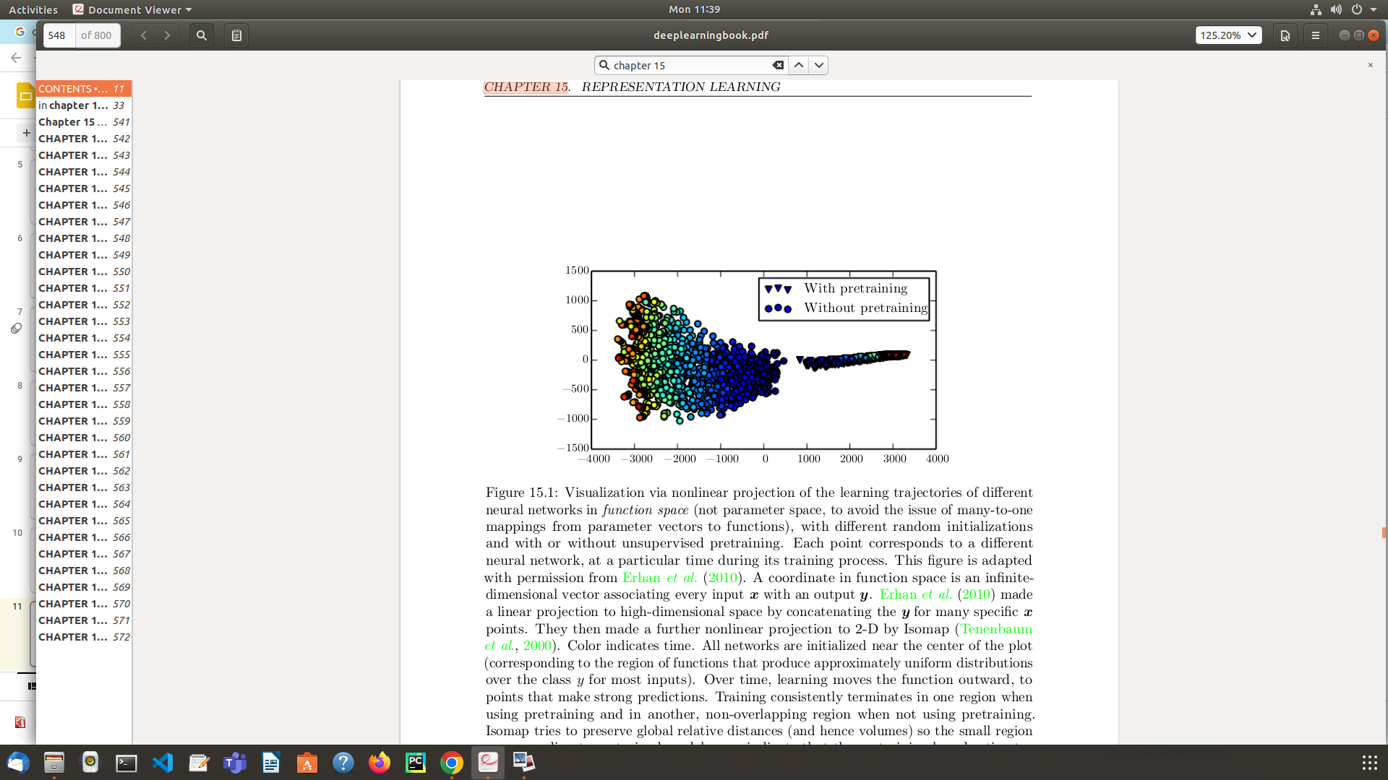
With pre-training & without pre-training

